Slide 1
7. Model Part 2

Slide 2
Outlier Detection and elimination (Standard Deviation)
Standard Deviation is statistical measure for detecting outlier in a dataset It helps to identify data points that deviate significantly from the mean of the data.
Generally, we follow +/- 3 or +/- 6 standard deviation on the dependent variable and remove the DMA or HCP from the modeling data set
Code –
PROC SORT DATA=OL ;BY DMANAME;RUN;
PROC STANDARD DATA=OL MEAN=0 STD=1 OUT=ZOL;
VAR Z_NRX; BY DMANAME;RUN;
DATA OL6;SET ZOL;WHERE Z_NRX BETWEEN -6 AND 6;RUN;
DATA OUTLIER;SET ZOL;WHERE Z_NRX <-3 OR Z_NRX >3;RUN;

Slide 3
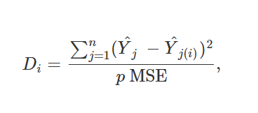
Outlier Detection and elimination (Cooks D)
Cook’s distance or Cook’s D is a commonly used estimate of the influence of a data point when performing least squares regression analysis.
It is useful for identifying outliers in the X values (observations for predictor variables). It also shows the influence of each observation on the fitted response values.
Y^j, is the prediction from the full regression model for observation j;
Y^j(i) is the prediction for observation j from a refitted regression model in which observation i has been omitted.
p is the number of fitted parameters in the model;
MSE is the mean square error of the regression model.

Slide 4
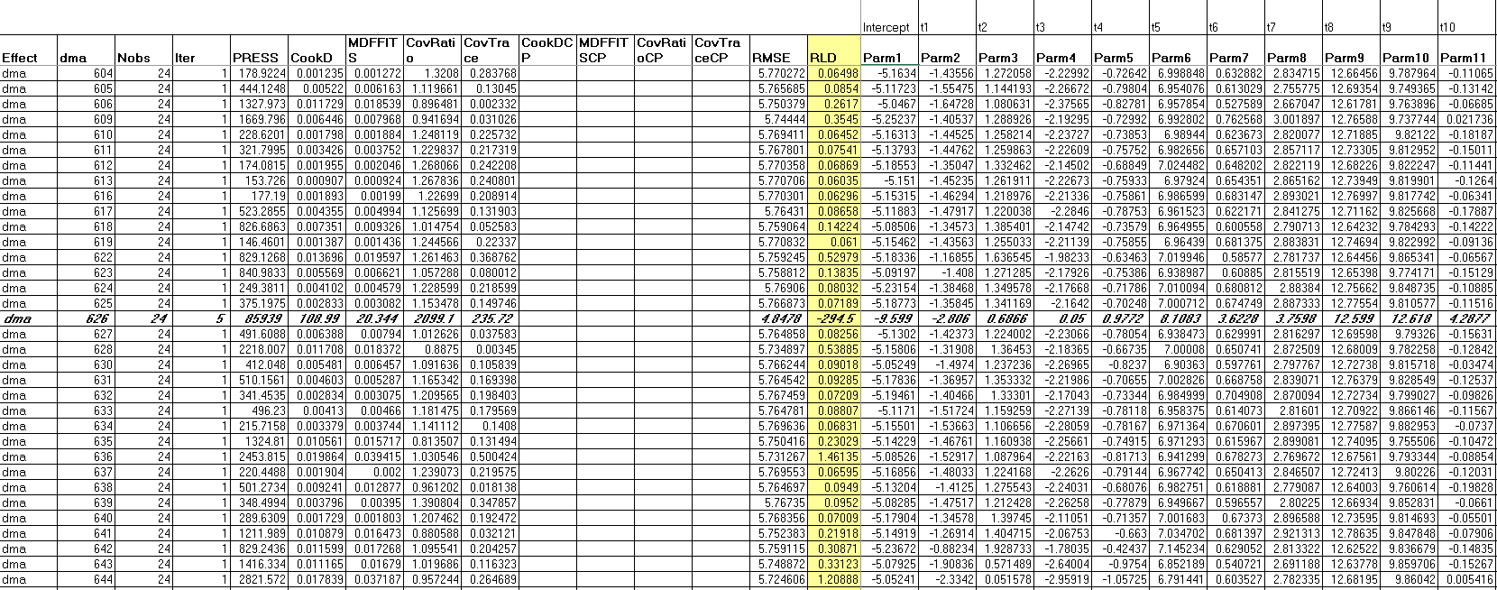
Outlier Detection and elimination (Cooks D)
Code-
PROC SORT DATA=MDL1_REDUCED;
BY DMA YEARMO; RUN;
PROC MIXED DATA=MDL1_REDUCED(WHERE=(OUTLIER_DMA_IND=0)) COVTEST NOCLPRINT EMPIRICAL;
CLASS DMA YEARMO;
MODEL PNASNRX = T1 - T24 MC_NRP LAG_PNASNRX
DETMD_40 SAMMD_50 GRPOMN_70 GRPOTC_60 GRPNAS_50*SEMS1 GRPNAS_50*SEMS2
/ SOLUTION OUTPRED=PRED_2;
RANDOM INTERCEPT / SUBJECT=DMA S;
ODS OUTPUT FITSTATISTICS=FIT1 SOLUTIONF=FIXED1 SOLUTIONR=RANDOM1;

Slide 5
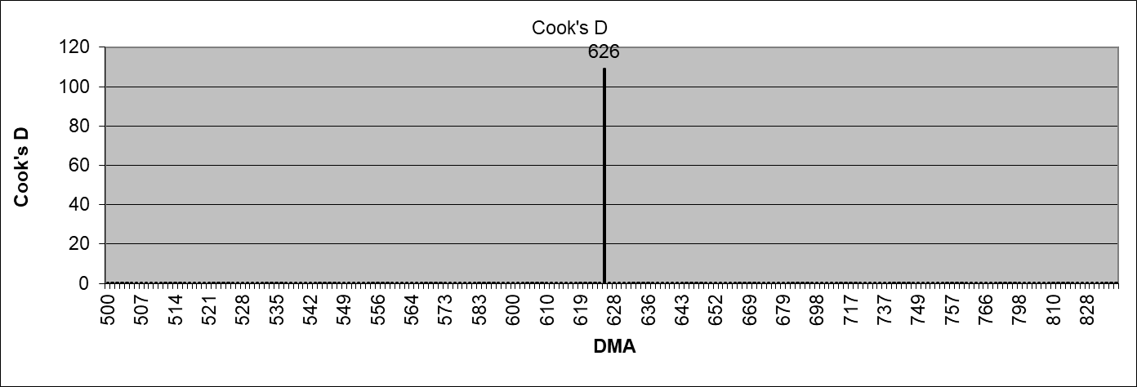
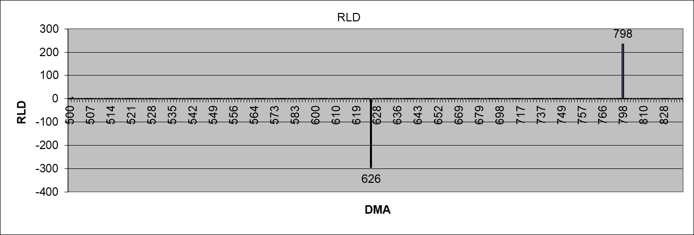
Outlier Detection and elimination (Cooks D)

Slide 6
DF Beta – Outlier Treatment
DF Beta statistic is a measure in regression analysis to assess the impact of individual data points on the coefficients of a regression model. It helps identify influential data points.
DF beta measures how much the estimated regression coefficients change when a particular data point is omitted from the analysis.
Code -
ODS GRAPHICS ON;
ODS OUTPUT PARAMETERESTIMATES=PEST;
PROC REG DATA=MODEL_DATA PLOTS(MAXPOINTS=NONE ONLY)= (COOKSD(LABEL) DFBETAS(LABEL UNPACK));
MODEL HCP_GRAIL_NRX=HCC_OSRCH_SESSIONS HCC_DISP_IMP /VIF;
ID DMA YEARMO; OUTPUT OUT=OUTPUT_DATA COOKD=COOKS_STATISTICS;
RUN;
ODS GRAPHICS OFF;

Slide 7
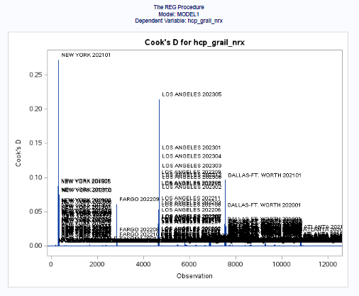
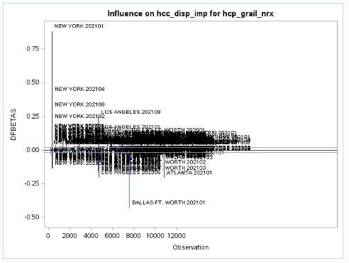
DF Beta – Outlier Treatment

Slide 8
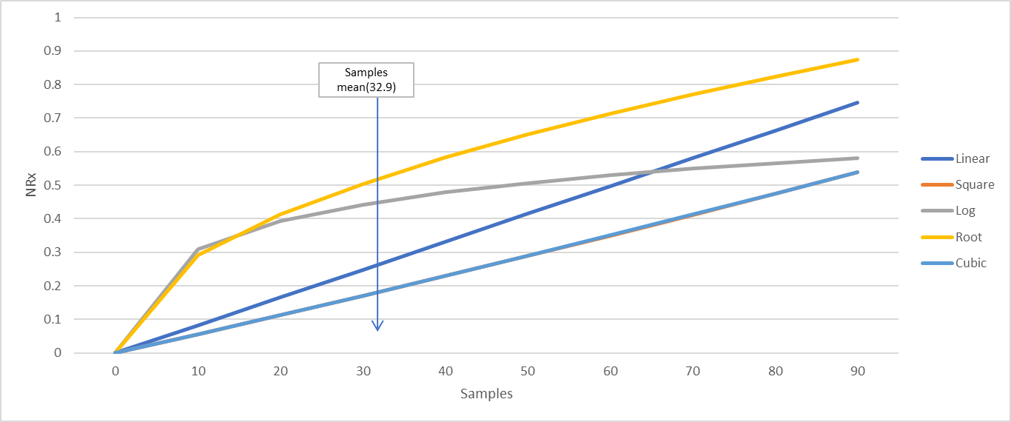
Parametric Models
Models have specified parametric structures for the variables, and these include having linear, log form, root form, polynomial degree – 2 and 3. We need to look out for the significance levels for these terms
Code -
PROC REG DATA=MDB_SV.MDL_ALL1 OUTEST = MDB_SV.MDL_ESTIMATES plots=none;
ID PARTY_ID;
M13: MODEL NRX_CUR = NRX_PRE MNRX_PRE TOT_MMF VNRX_CUR TOT_DET_CUR SAMPLES_CUR/ RSQUARE VIF CLB ALPHA=0.10;
M14: MODEL NRX_CUR = NRX_PRE MNRX_PRE TOT_MMF VNRX_CUR TOT_DET_CUR SAMPLES_CUR SAMPLES_CUR_SQ / RSQUARE VIF CLB ALPHA=0.10;
M16: MODEL NRX_CUR = NRX_PRE MNRX_PRE TOT_MMF VNRX_CUR TOT_DET_CUR SAMPLES_CUR_LN / RSQUARE VIF CLB ALPHA=0.10;
M17: MODEL NRX_CUR = NRX_PRE MNRX_PRE TOT_MMF VNRX_CUR TOT_DET_CUR SAMPLES_CUR_ROOT / RSQUARE VIF CLB ALPHA=0.10;
M18: MODEL NRX_CUR = NRX_PRE MNRX_PRE TOT_MMF VNRX_CUR TOT_DET_CUR SAMPLES_CUR SAMPLES_CUR_SQ SAMPLES_CUR_CU/ RSQUARE VIF CLB ALPHA=0.10;
RUN;

Slide 9
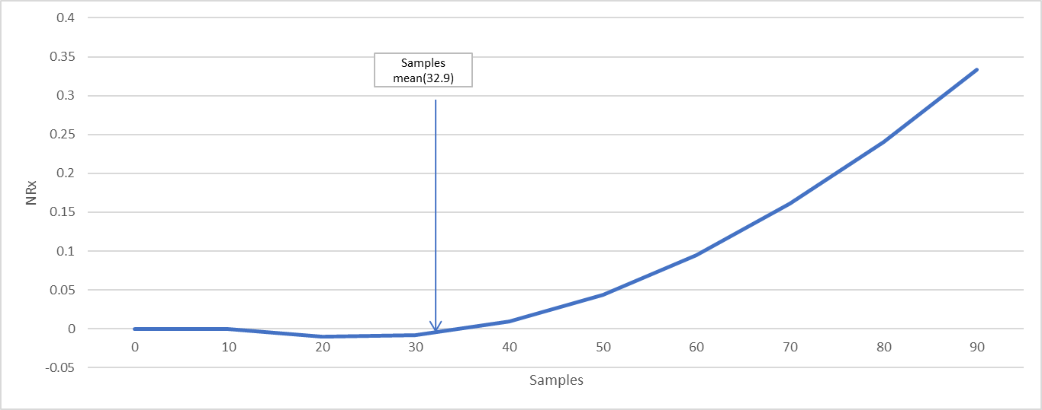
Semi-Parametric Method [PROC GAM]
Models have specified parametric structures for the variables and adds either a spline or loess component to variables of interest.
Convergence is far better than PROC LOESS. There are several model assumptions made internally (refer SAS manuals for GAM and LOESS to understand differences).
Code -
PROC GAM DATA=MDB_SV.MDL_ALL1 PLOTS(UNPACK)=COMPONENTS(ADDITIVE CLM);
MODEL NRX_CUR1= PARAM(NRX_PRE1 MNRX_PRE TOT_MMF VNRX_CUR TOT_DET_CUR) SPLINE(SAMPLES_CUR) / METHOD = GCV ;
ODS OUTPUT GAM.PARAMETERESTIMATES = GAM1;
SCORE DATA=MDB_SV.SAMPLE_CURVES OUT=SAMPLE_GAM;
RUN;

Slide 10
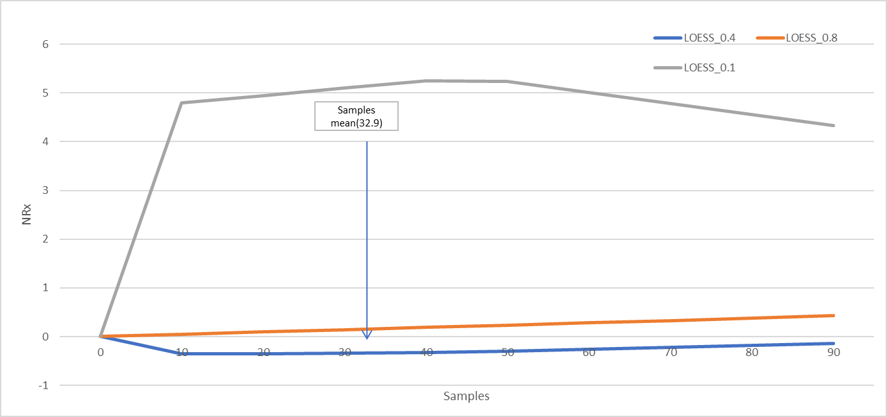
Non-Parametric Models [PROC LOESS]
Algorithm works by considering local regression trees and smoothing various local predicted values. No constraints on shapes are assumed.
Does not support more than 15 variables. Convergence becomes hard (or mostly impossible) for more than about few thousand observations.
Code -
PROC LOESS DATA=MDB_SV.MDL_ALL1 PLOTS(MAXPOINTS=NONE ONLY);
MODEL NRX_CUR1 = NRX_PRE1 MNRX_PRE TOT_MMF VNRX_CUR TOT_DET_CUR SAMPLES_CUR
/ SMOOTH= 0.4 RESIDUAL ALL DFMETHOD=NONE;
SCORE DATA=MDB_SV.SAMPLE_CURVES/ CLM;
ODS OUTPUT OUTPUTSTATISTICS=RESULTS SCORERESULTS=SCORE_DATA_MN_OUT;
RUN;

Slide 11
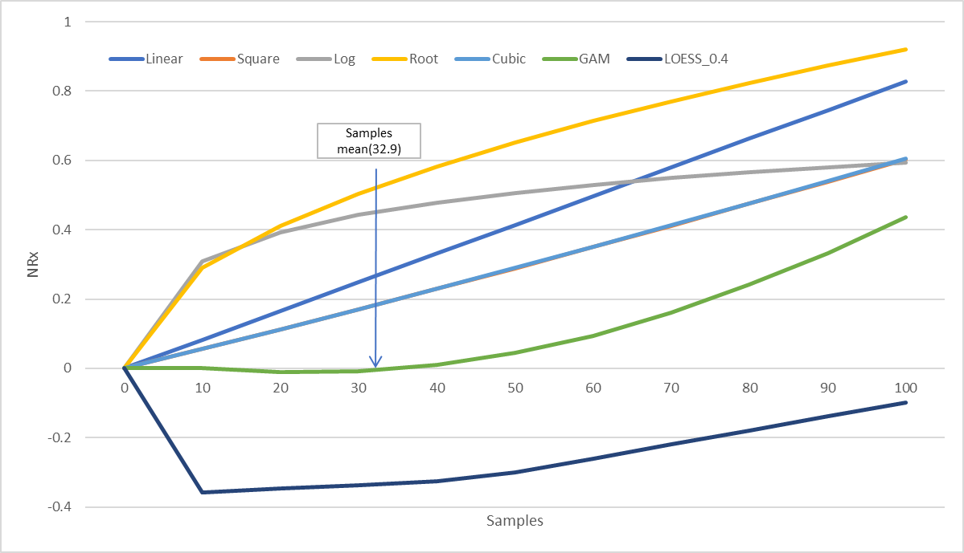
Discussion on shapes of different response curves
As non-parametric curve seems to have convergence issues, using Splines from Semi-Parametric models for appropriate guidance on underlying shape of the response curve
Log and SQRT are way off at mean and over projects – this is observed in multiple cases, particularly for LOG curves.
Avoid LOG curves to the extent possible to avoid over projection.
Generally Polynomial or Power curves with high powers (>0.6) comes closer to splines and are preferable.

Slide 12
Appendix

Slide 13
Influence Diagnostics
Influence Diagnostics identifies Outlier DMA’s that unduly impacts the estimates (particularly GRPNAS).
PRCO MIXED has INFLUENCE option that generates many different statistics to identify outliers. Outliers could be classified in terms of:
OVERALL Influence (look for high Restricted Likelihood Distance)
Overall Influence can be categorized into:
Fixed Estimates Influence (Look for Higher Cook's D)
Fixed Estimates Significance Level or precision (Look for COVRATIO far from 1. High Covratio results in lower precision)
Note: Show some of the diagnostic charts from Excel.
Once Outliers are identified (usually a couple of DMA’s), remove them from data and run the final model again.

